Slide 1


THINK PAIR SHARE
“When you hear the word REGION/ REGION OF ASIA,
what comes to your mind? Countries? Culture?
Geography? Or teamwork?”
Steps:
1.Think individually (1 min)
2. Pair up to discuss (3 min)
3. Share insights with the class

Slide 2
GROUP ACTIVITY
WHAT ARE THE REGIONS OF ASIA?
WHAT ARE THE SIGNIFICANT EVENTS HAPPENED ON EVERY REGIONS OF ASIA?

Slide 3
- - e e
a - -
ImpoAnt in the Silk Road Pade (Roman Empire
and China)
Cradle of ancient civilizations — China, Japan
and Mongolia
High population densiĘ; cradle of Indian
civilization
Located in the Asia-Pacific Ring of Fire; historically the goal destination ofthe European expeditions that search for spice
Many are ańd desert regions but sewe as a
gateways to major bodies of water in the wo¥d
•
•
••

Slide 4


THE CONTEMPORARY WORLO

Slide 5
ASIA IS THE LARGEST AND MOST POPURTED CONTINENT IN THE WORLD. GEOGRAPHICALLY, IT IS SEPARATED FROM THE EUROPEAN CONTINENT BY THE URALS, FROM AFRICA BY THE SUEZ CANAL, FROM THE NORTH AMERICA BY THE BERING STRAIT. IT IS COMPRISED OF DISTINCT REGIONS SUCH AS CENTRAL ASIA, EASTASIA, SOUTH ASIA, SOUTHEASTASIA, AND THE MIDDLE EAST.

Slide 6

ASIA HAS BEEN THE CRADLE OF SEVERAL ANCIENT CIVILIZATIONS SUCH AS THE CHINESE, INDIAN, AND KHMER CIVILIZATIONS.

Slide 7
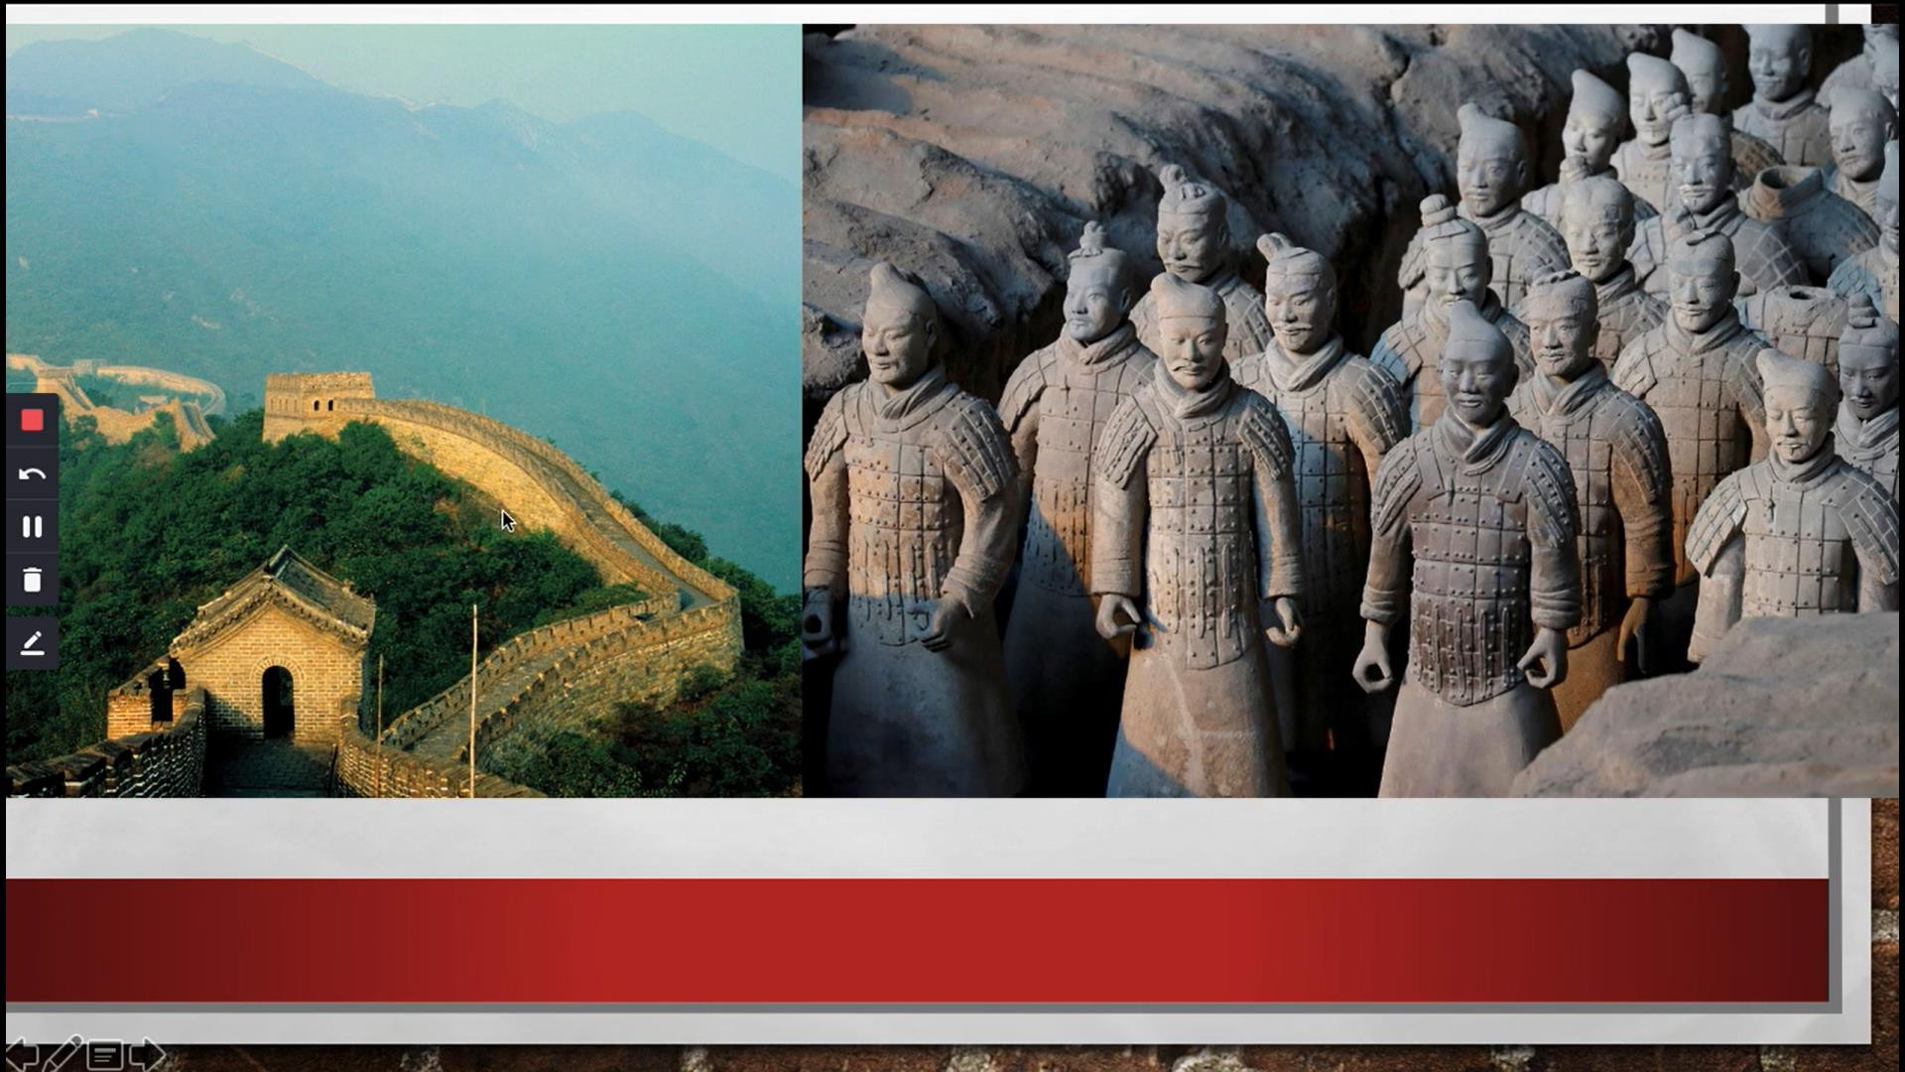

Slide 8
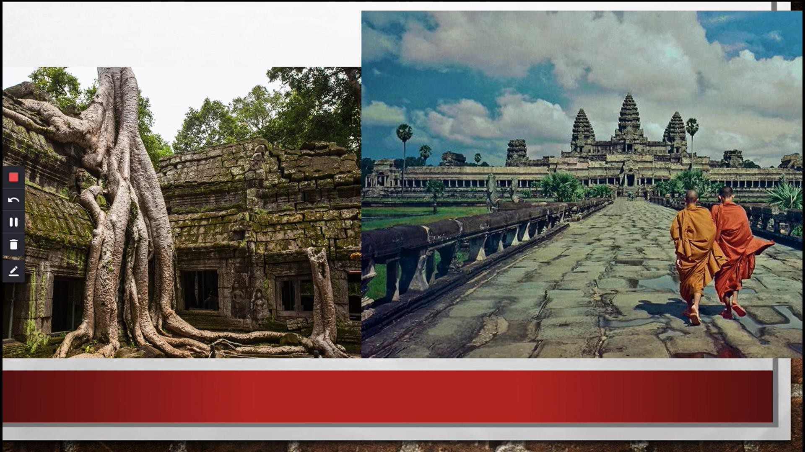

Slide 9
ASIA HAS ALSO BEEN THE HOME OF INFLUENTIAL CULTURAL, PHILOSOPHICAL, AND RELIGIOUS MOVEMENTS. HINDUISM, JUDAISM, CHRISTIANIW, BUDDHISM, TAOISM, AND OTHER ORIENTAL PHILOSOPHIES AND RELIGIONS GENERALLY ORIGINATED FROM AN ASIAN COUNTRY AND HAVE PROLIFERATED AROUND THE GLOBE.

Slide 10
- - e e
a - -
ImpoAnt in the Silk Road Pade (Roman Empire
and China)
Cradle of ancient civilizations — China, Japan
and Mongolia
High population densiĘ; cradle of Indian
civilization
Located in the Asia-Pacific Ring of Fire; historically the goal destination ofthe European expeditions that search for spice
Many are ańd desert regions but sewe as a
gateways to major bodies of water in the wo¥d
•
•
••

Slide 11
in the contemporary worid, Asia has become an economic force characterized by reduced poverty and fast pace economic development (ADB, 2008).
sia was the central giobal force in the early modern orld economy. It was the site of the most important
rade routes and in some places more advanced in
technoiogythan West such as science and medicine.

Slide 12
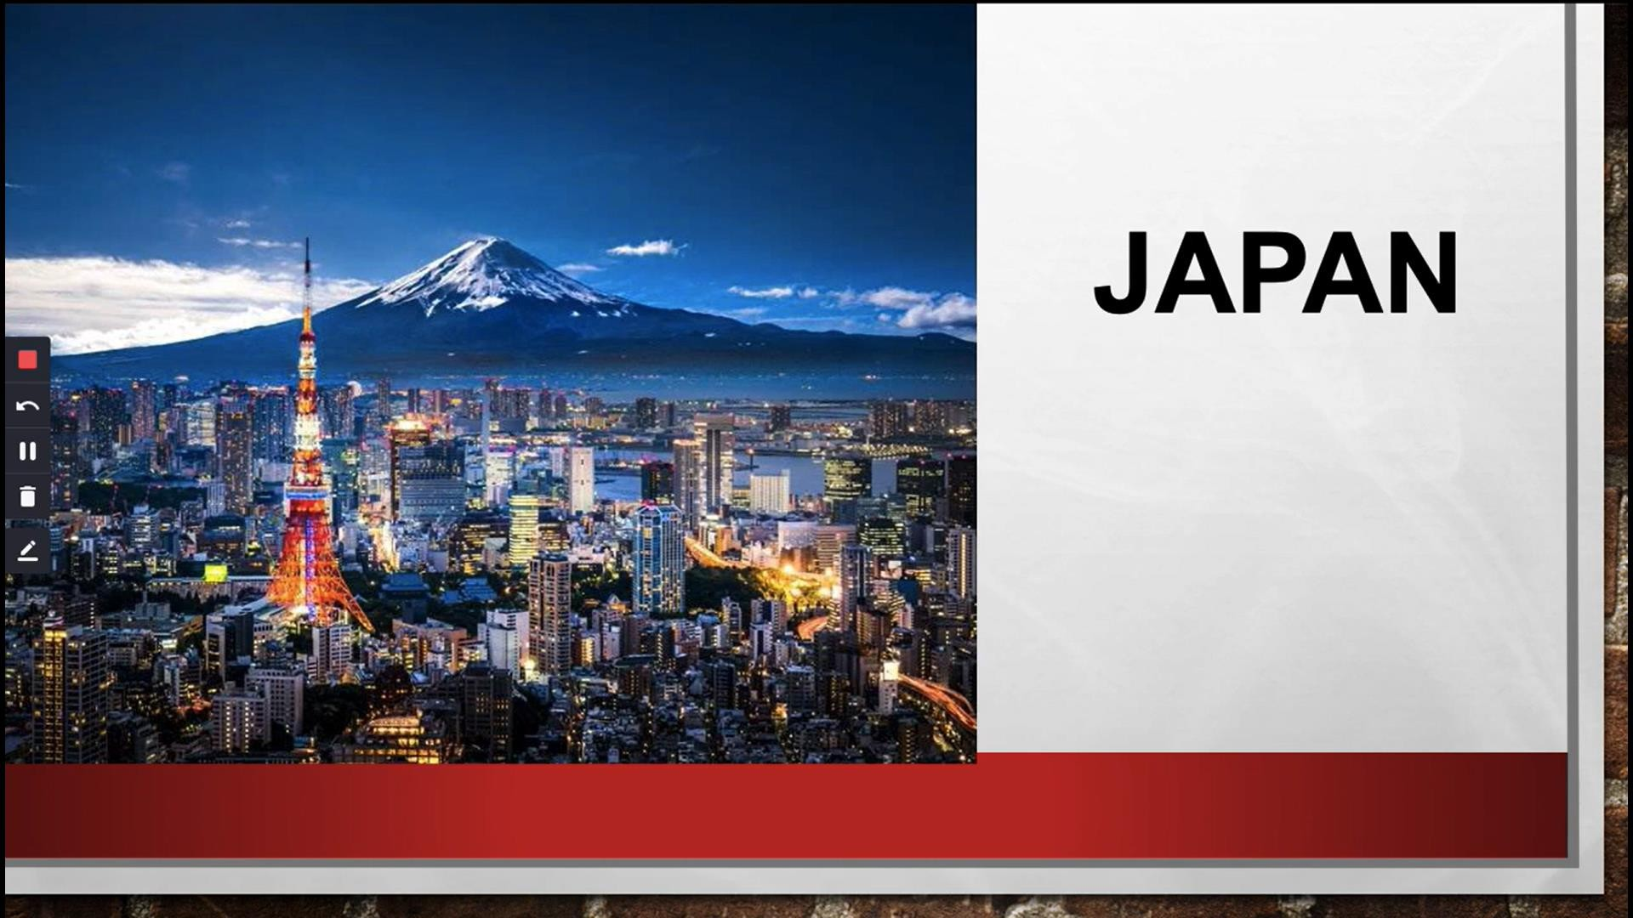

Slide 13
JAPAN
Japan embarked on procuring raw materiais iike coai and iron at unprecedented economies of scaie aiiowing them to gain a competitive edge in the giobai manufacturing market as weii as giobaiized shipping and procurement patterns which other countries modeied.

Slide 14
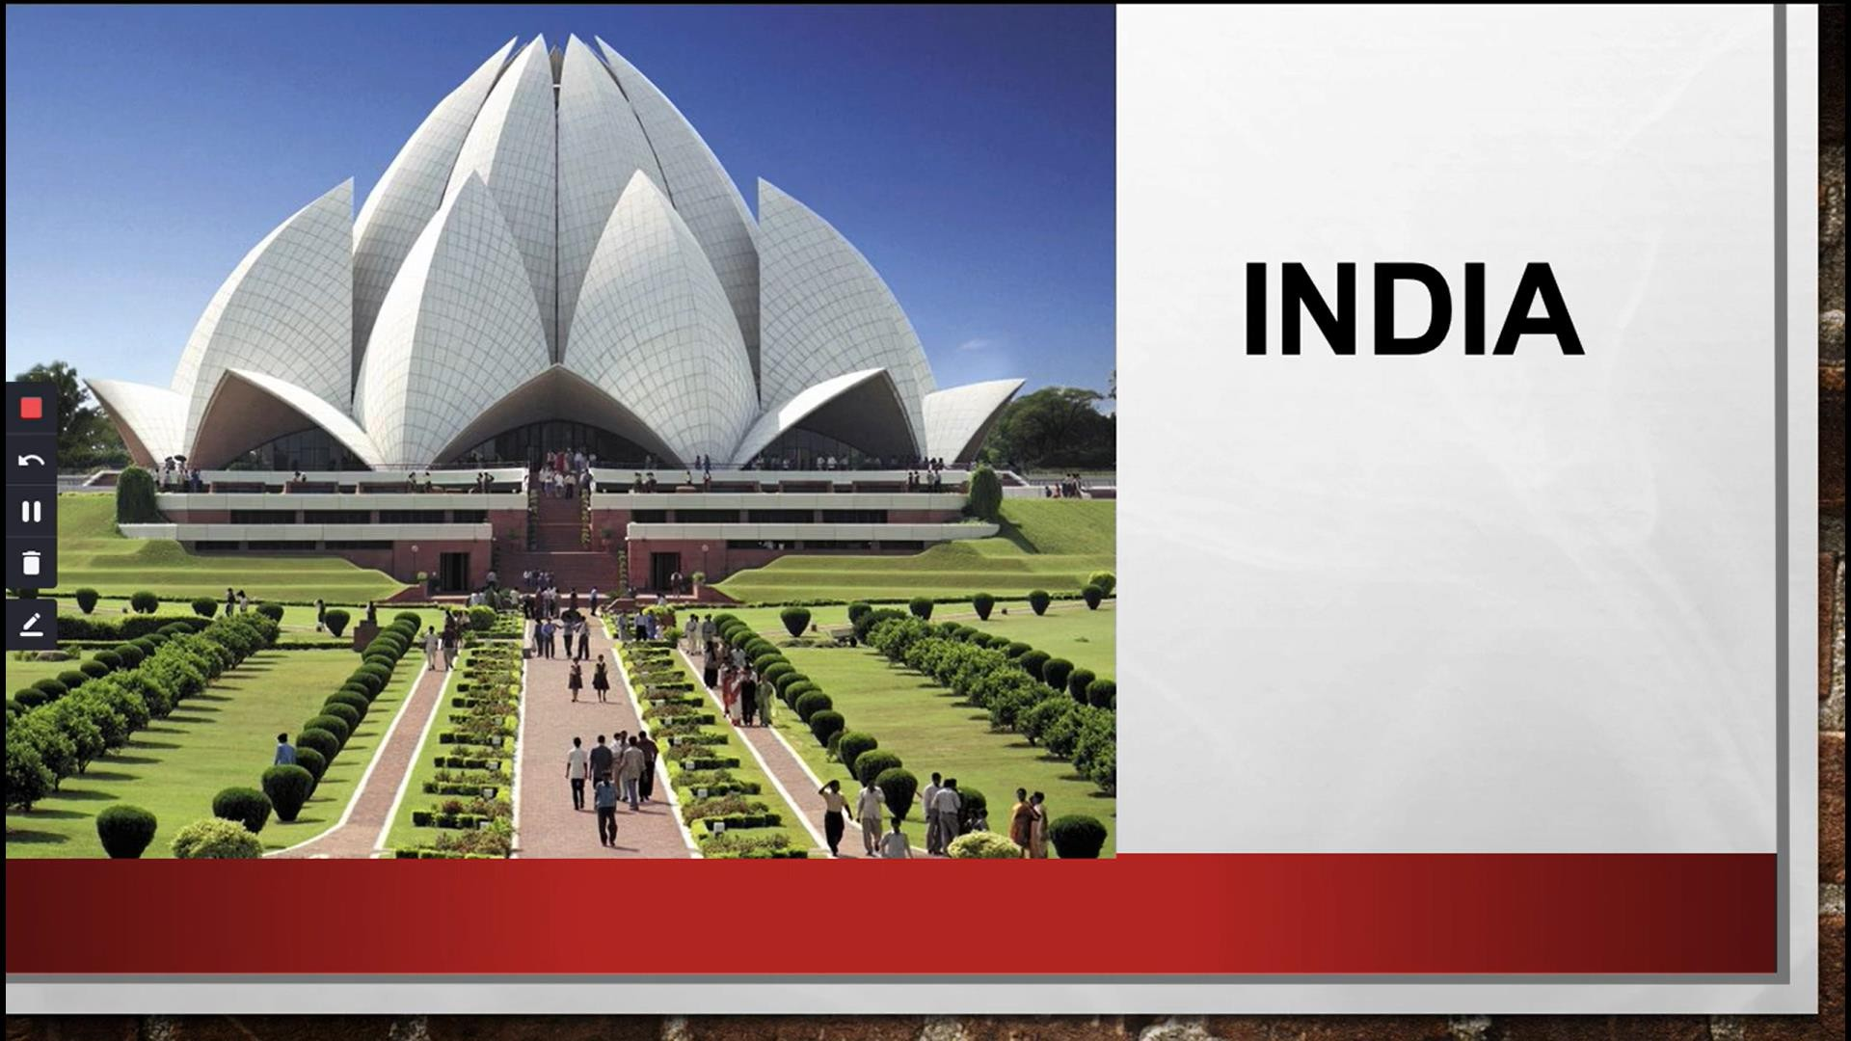

Slide 15

INDIA
India opened -up and emphasized an expoJ- orientedstrategy.Textiles and other low wage sectors have been a key pal of the economy with highly successful soRware developmentexports.

Slide 16
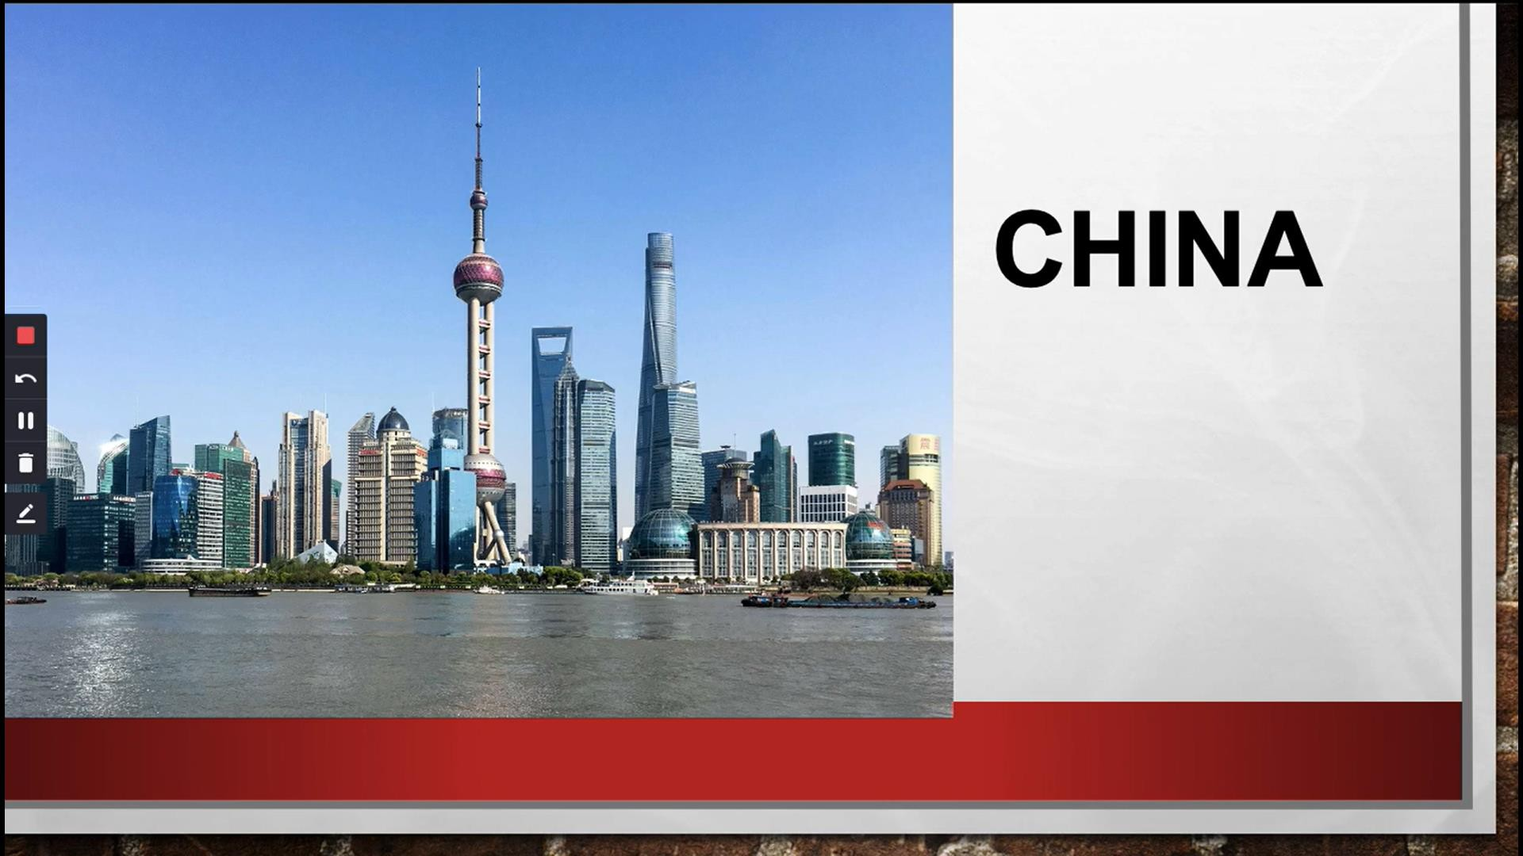

Slide 17

CHINA
China pursues similar pattern of developmen at present and is now the world's largest impoJers of basic raw materials such as iron and surpassed Japan, the US and Europe in

Slide 18
INDIA AND CHINA HAVE ALSO BECOME A MAJOR SOURCE OF INTERNATIONAL MIGRANT LABOR, WHICH IS ALSO ONE OF THE FUNDAMENTAL CHARACTERISTICS OF THE ERA OF GLOBALIZATION. THIS INCLUDES THE MIGRATION OF
HIGHLY SKILLED LABOR INTO THE HIGH- TECH INDUSTRY
BASED IN SILICON VALLEY.
INDIA, CHINA AND THE PHILIPPINES WERE THREE OF THE TOP FOUR RECIPIENT STATES OF MIGRANT REMITTANCES.

Slide 19

IN CULTURE AND GLOBALIZATION IN THE REGION,ASIA HAS BEEN THE SOURCE OF A WIDE VARIEW OF CULTURAL PHENOMENATHAT
HAVE SPREAD OUTWARD TO THE WESTERN
COUNTRIES AND THE REST OF THE WORLD.

Slide 20


Slide 21


Slide 22


Slide 23
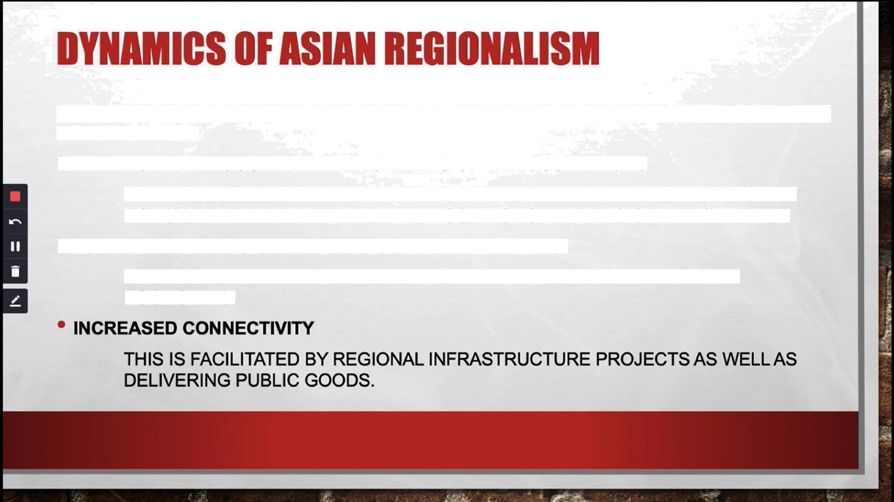
ADB (2008) IDENTIFIED SOME FACTORS THAT ARE INFLUENTIAL IN THE INTEGRATION OF
ASIAN NATIONS.
ENHANCED DIALOGUE BETWEEN CITIZENS OF VARIOUS NATIONS
THIS IS FACILITATEO BY GROWING TOURISM ACTIVITIES IN THE REGIONS ANO
CONSISTENT MULTILATERAL MEETINGS AMONG LEADERS OF NATION-STATE.
EXPANDING INTRAREGIONAL TRADE AND INVESTMENTS
THIS BRINGS FORTH CLOSER FINANCIAL MARKETS AND INDEPENDENT
ECONOMIES.

Slide 24

IT HARNESSES THE STRENGTH OF DIVERSE ECONOMIES.
IT PROVIDES PLATFORM FOR CONNECTING FINANCIAL MARKETS.
IT MAKES THE ECONOMY MORE RESILIENT TO GLOBAL RISKS.
IT POOLS RESOURCES.
IT CREATES REGIONAL MECHANISMS FOR SAFETY AND

Slide 25

THERE IS A NEED TO ESTABLISH COMPATIBLE PRODUCT STANDARDS.
THE NEED TO ESTABLISH GUIDELINES THAT BUFFER FINANCIAL CONTAGION AND ENSURE COMPATIBLE FINANCIAL REGURTIONS.
THE NEED TO COORDINATE MACROECONOMIC POLICIES.
THE NEEO TO MANAGE CROSS-BOROER ENVIRONMENTAL AND SOCIAL POLICIES (E.G. FAIR TREATMENT OF MIGRANT

Slide 26

THERE IS A NEED TO ESTABLISH COMPATIBLE PRODUCT STANDARDS.
THE NEEO TO ESTABLISH GUIDELINES THAT BUFFER FINANCIAL CONTAGION AND ENSURE COMPATIBLE FINANCIAL REGULATIONS.
THE NEED TO COORDINATE MACROECONOMIC POLICIES.
THE NEEO TO MANAGE CROSS-BORDER ENVIRONMENTAL AND SOCIAL POLICIES (E.G. FAIR TREATMENT OF MIGRANT

Slide 27
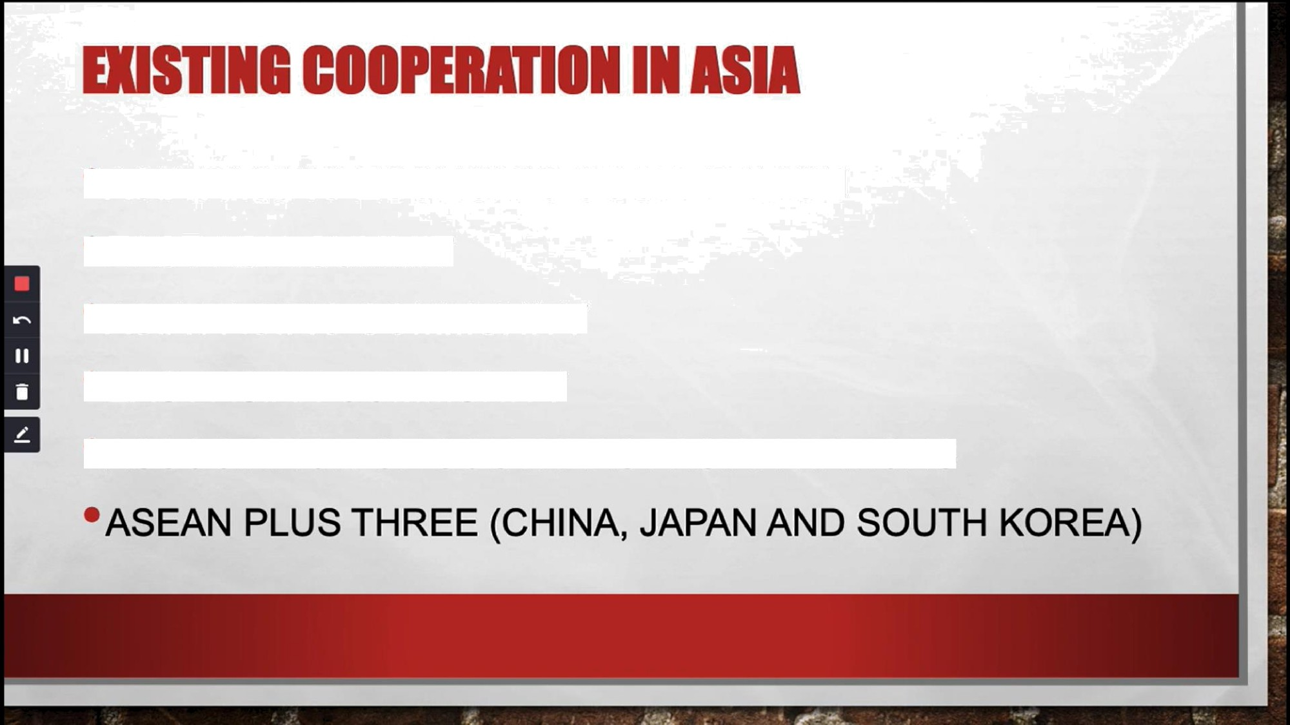
•ASIA PACIFIC ECONOMIC COOPERATION
EAST ASIA SUMMIT
•ASIA PACIFIC COMMUNITY
EASTASIAN COMMUNITY
•ASS0CIATION OF SOUTHEASTASIAN NATIONS

Slide 28
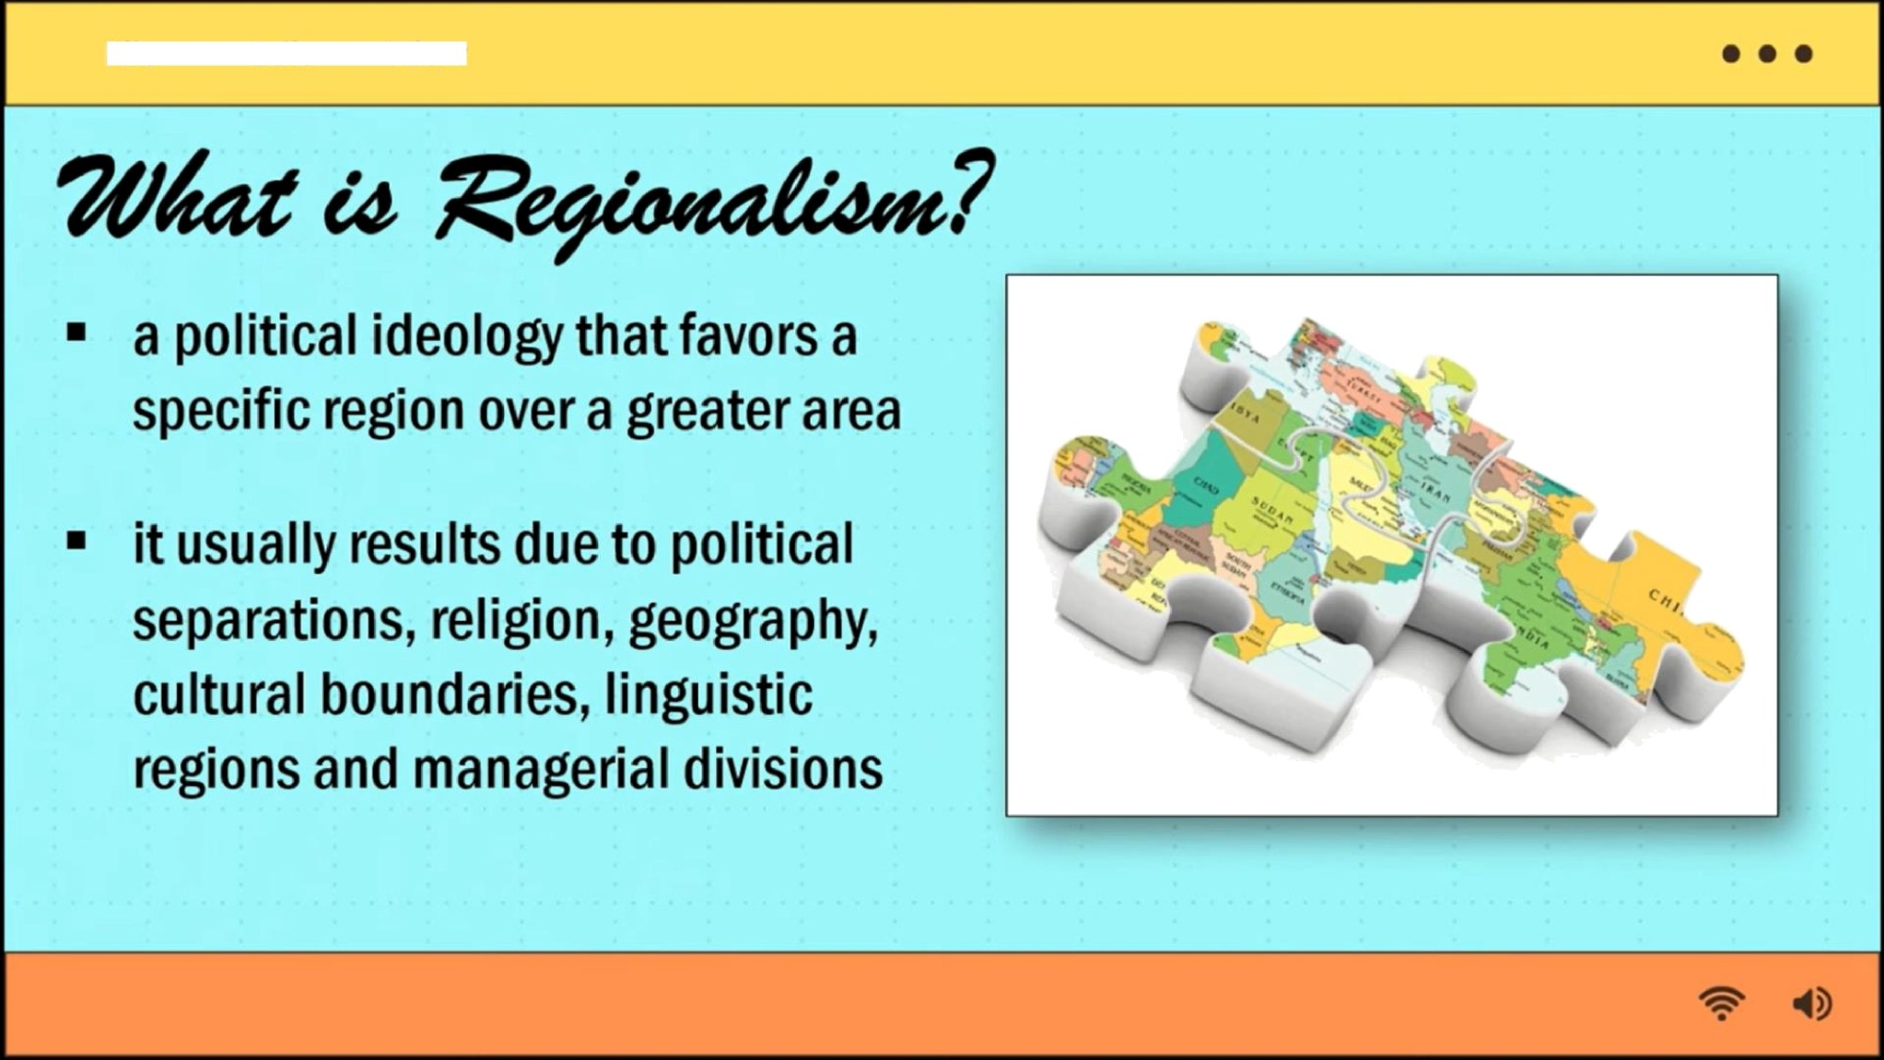
View
File
Edit

Slide 29

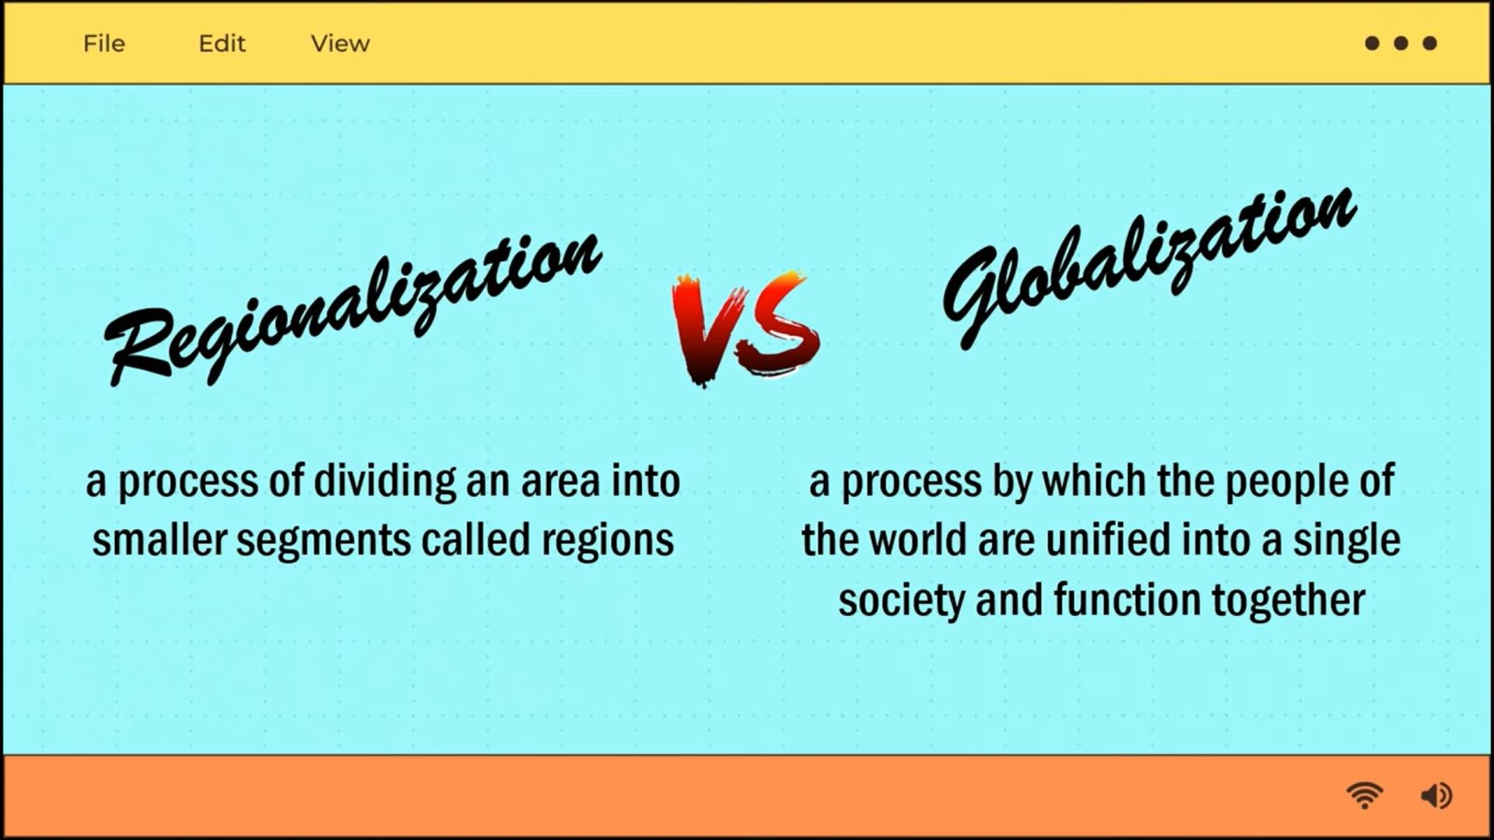

Slide 30
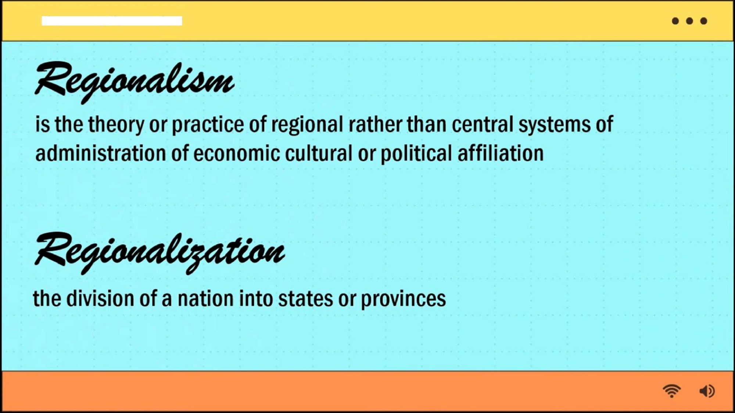
View
File
Edit

Slide 31
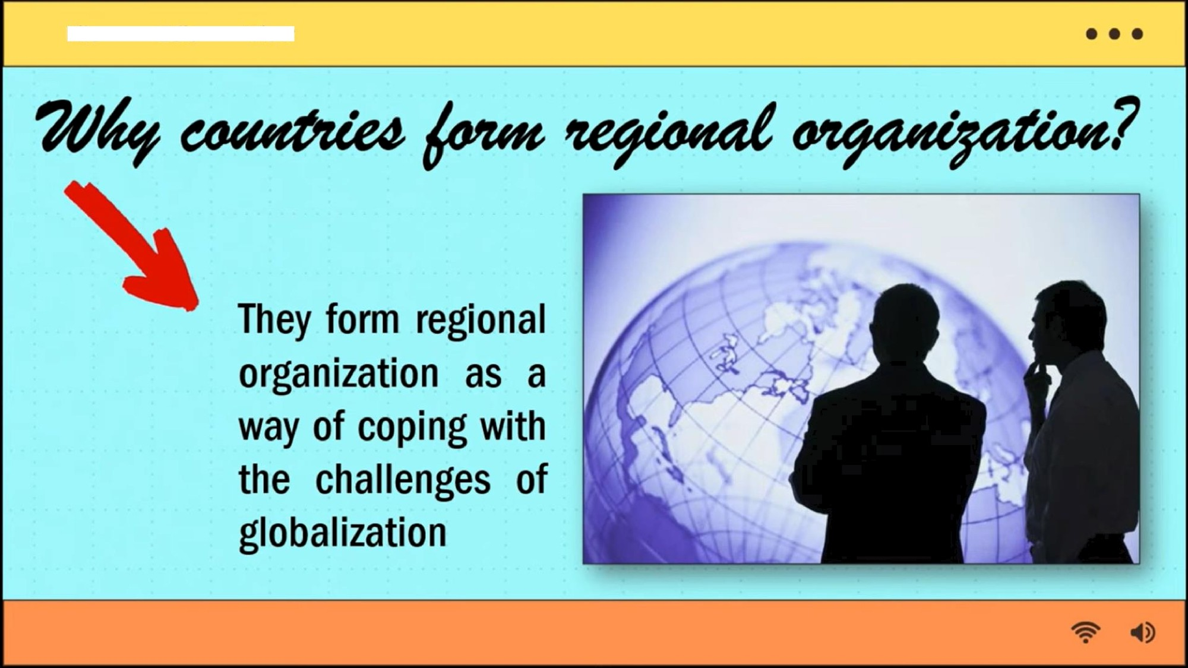
File
Edit
View

Slide 32
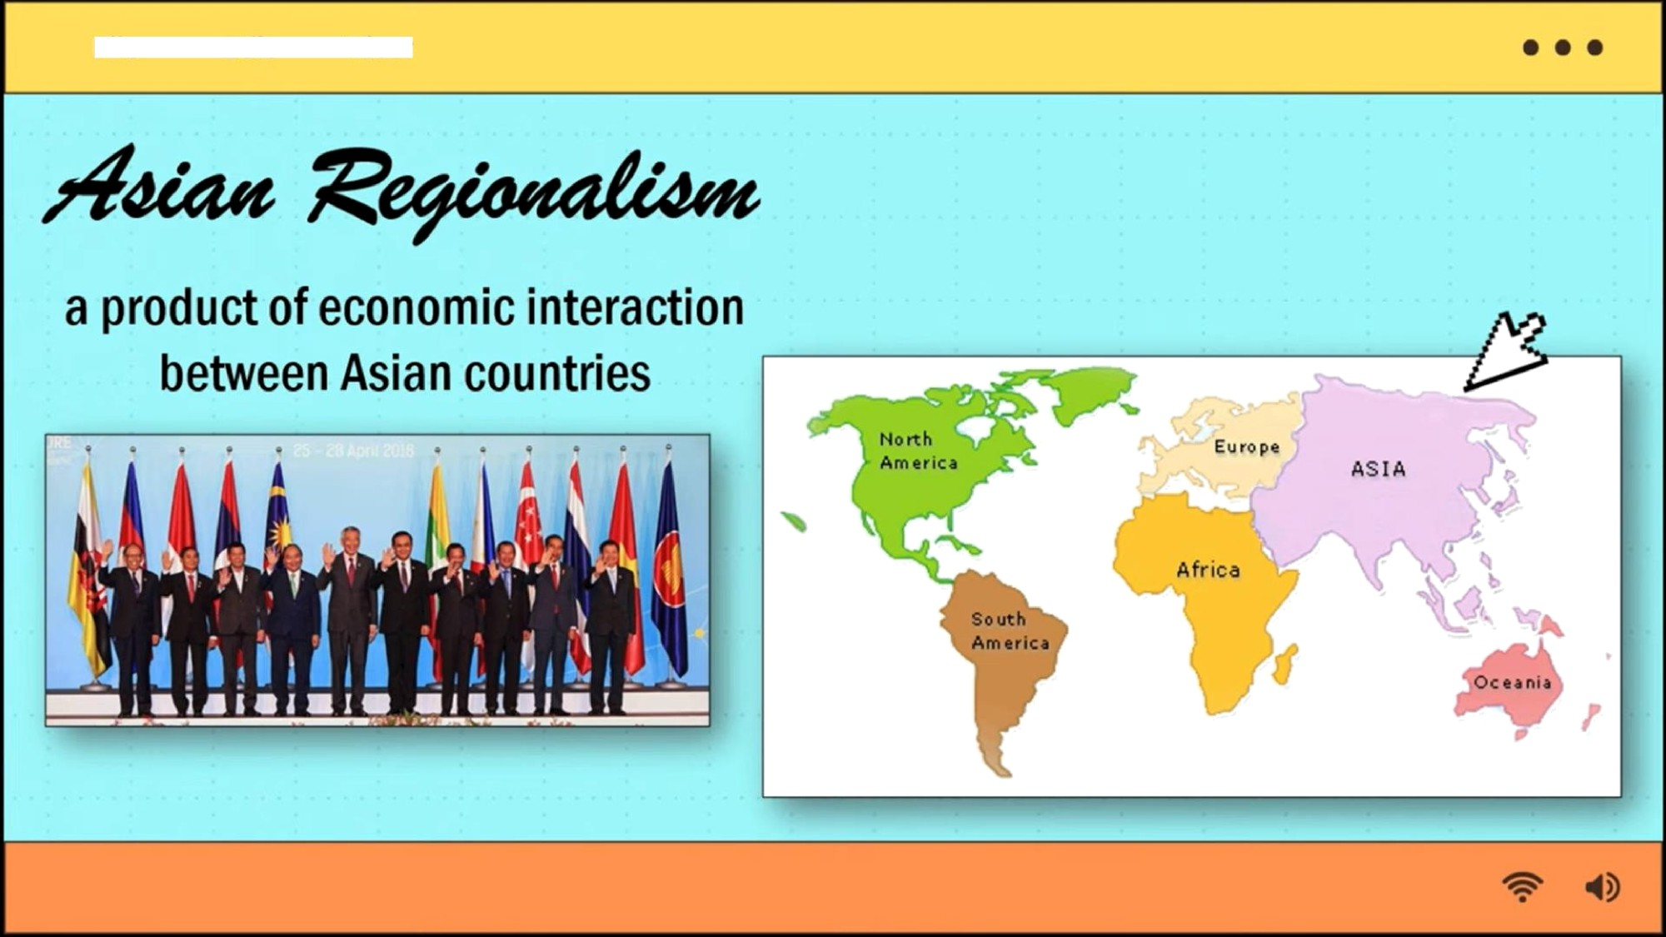
File
Edit
View

Slide 33
File
Ed“it
View
o o o
Asian economies ha›e grown not only richer, but also closer together.
Newtechnoiogicaitrendshavefuxherstrengthened ties among them, as have the rise of the China and India and the region's growing weightin the global economy.
The 1997/1998 financial crisis dealt a severe setback too muchof the region, highlighting Asia s shared interests and common vulnerabilities and providing animpetusforregionalcooperation.

Slide 34

File
Edit
View
o o o
how, Asian economies are becoming closely inteNined.
•
Interdependence is deepening because Asia s economies have grownlarge and prosperous enough to become impo1ant to each other, and because their paxerns of production increasingly depend on neLorks that span severai Asian economies and involve wide ranging exchanges of paM and componenxamongthem.

Slide 35
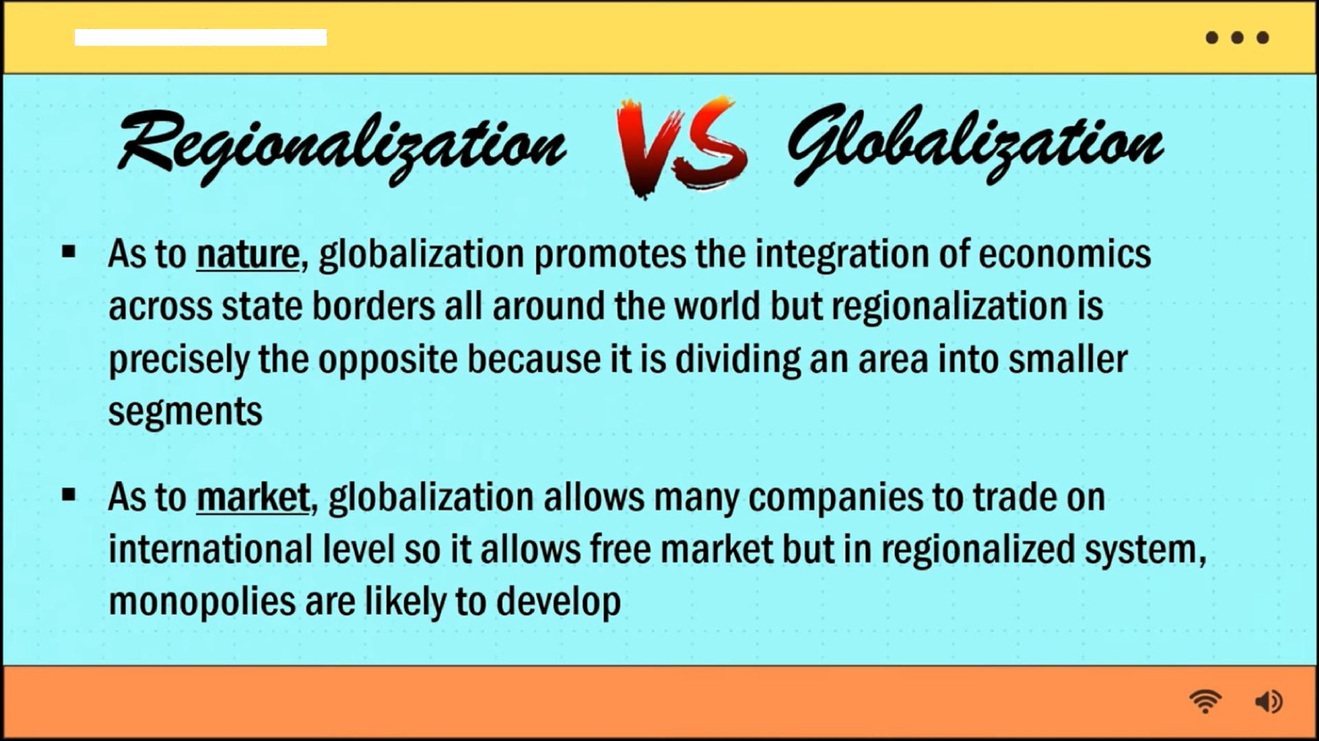
Pile
Edit
View

Slide 36
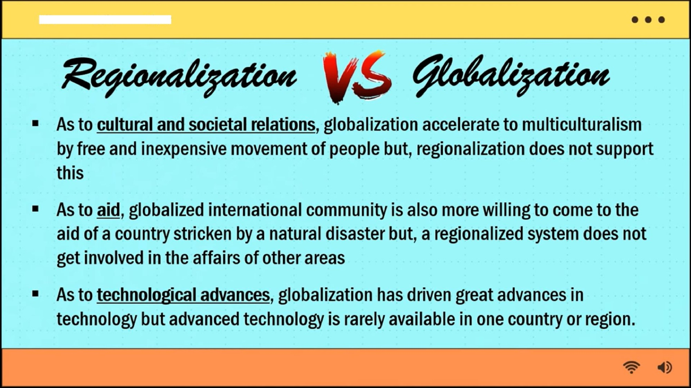
File
Edit
View

Slide 37
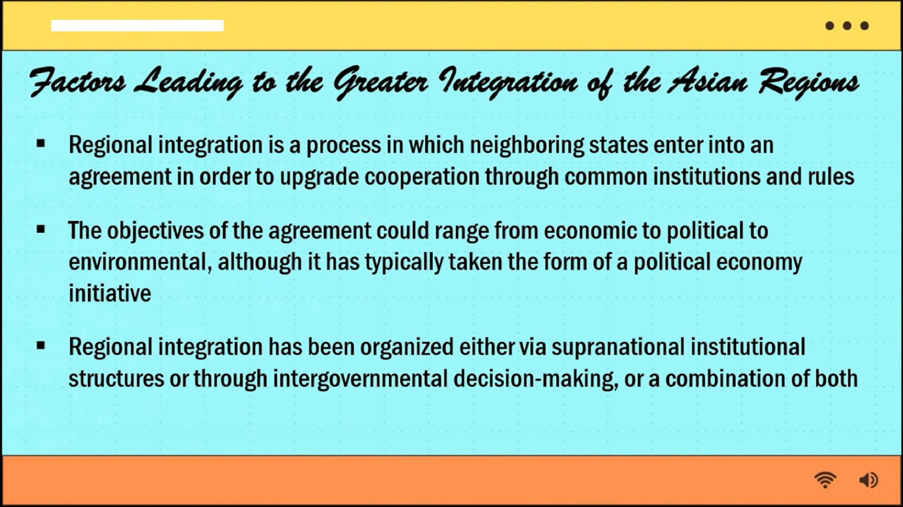
View
File
Edit

Slide 38
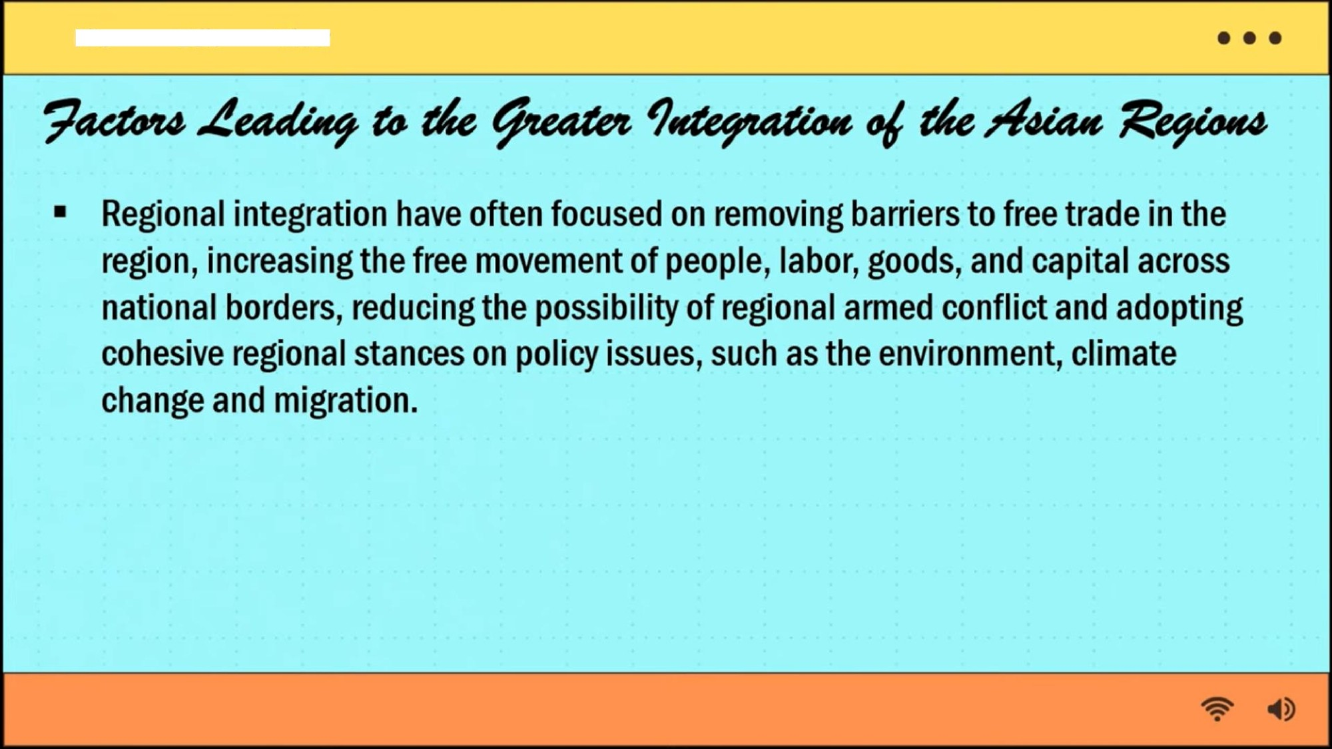
View
File
Edit

Slide 39
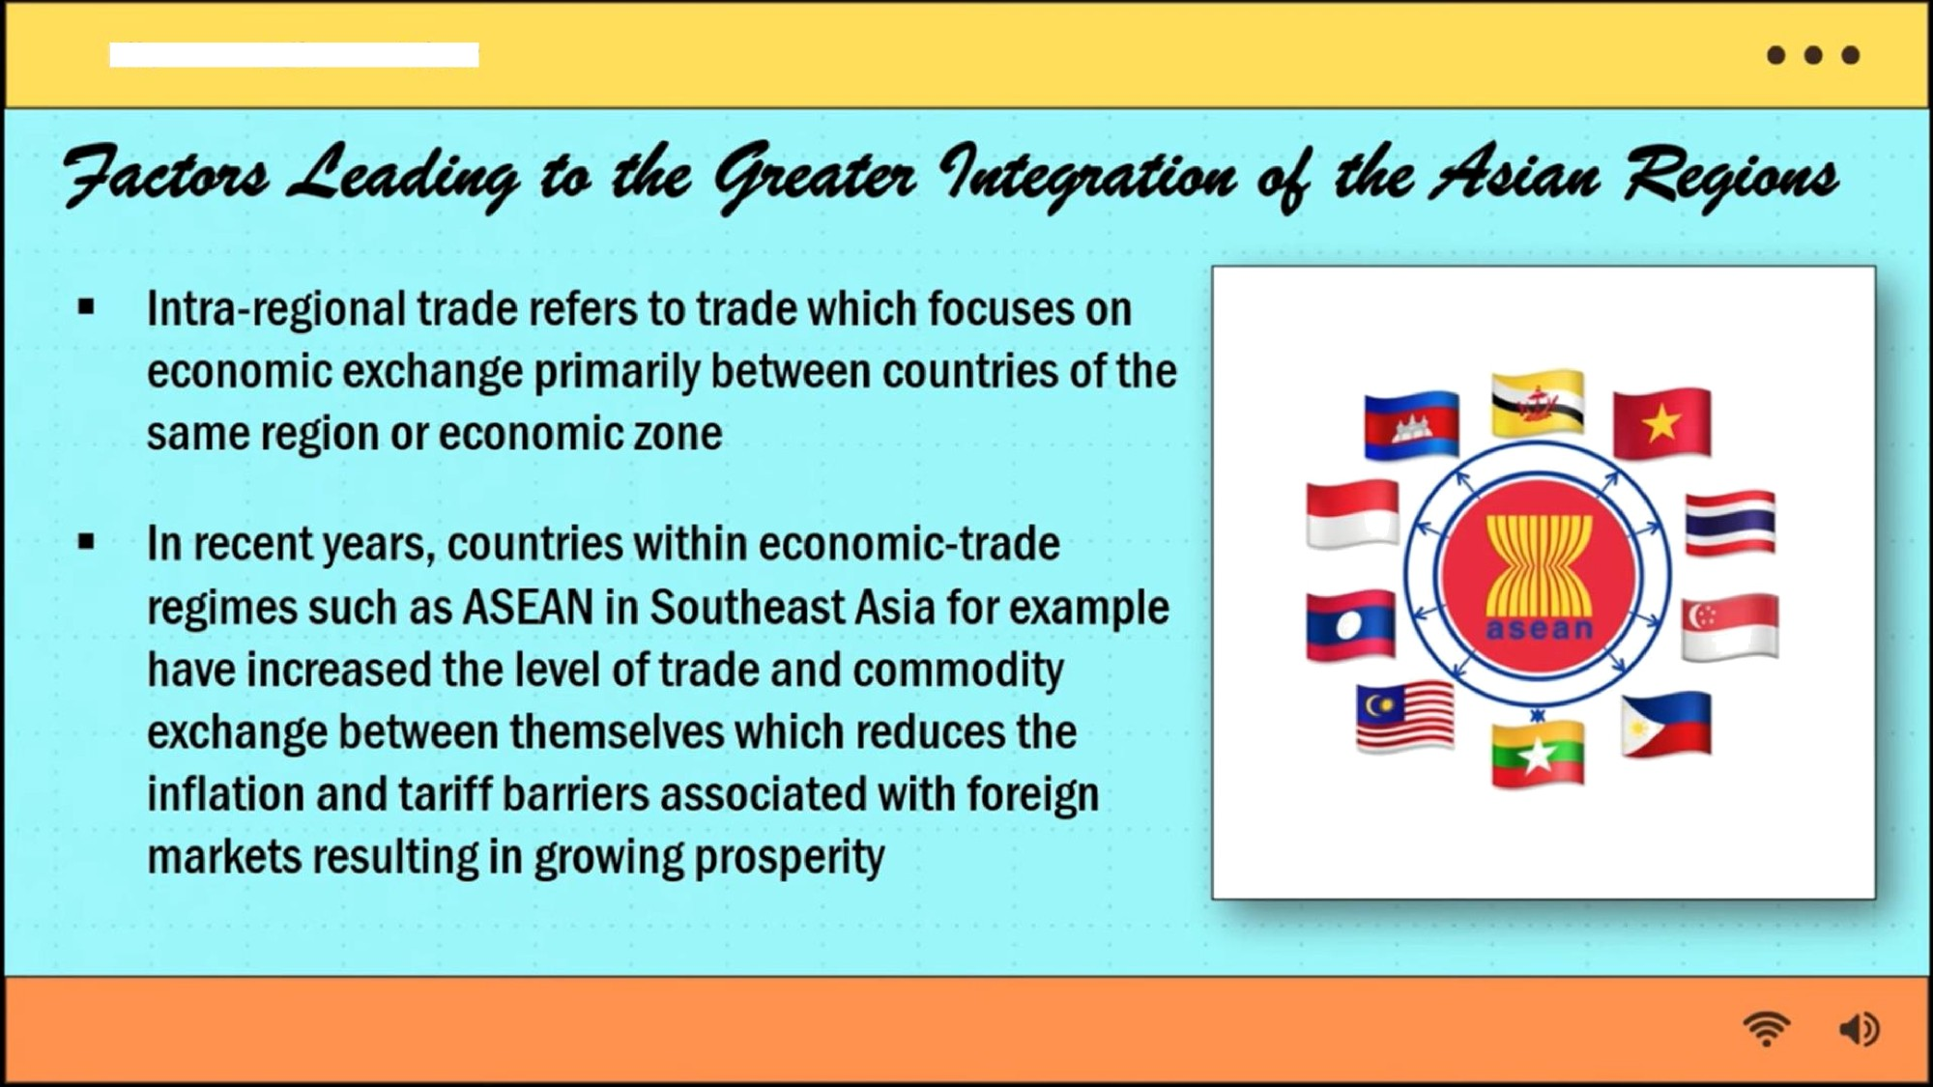
View
File
Edit

Slide 40
ASSESSMENT:
Answer in 3–5 sentences.
Why is Asian Regionalism important for the economic development of Asian countries?
How did the 1997 Asian Financial Crisis influence East Asian cooperation?
What are the positive and negative effects of globalization on Asian Regionalism?
Explain one major challenge that prevents full unity among Asian regions.
In your own understanding, how can Asia strengthen its regional cooperation
in the future?

Slide 41
AGREEMENT:
What is the Asian Regionalism?
What is the advantage and disadvantage of Regionalism?
What is the role of ASEAN?
Does Globalization affects Regionalism? Why?

